Slide 1
Effects of fragmentation on route charges
Status quo analysis and potential alternatives
Goran Pavlovic, PhD student, University of Belgrade, Serbia
Prof. Dr. Frank Fichert - Worms University of Applied Sciences, Germany

Slide 2
Background and motivation
Current Central Route Charges Office (CRCO) route charging scheme – negative effect of aircraft taking (or at least filing) detours around charging zones with higher unit rates (Delgado, 2015).
Policy negatively impacting operations!
Fuel , CO₂ , traffic shifts etc.
Ongoing discussions on innovative charging and pricing mechanisms:
Airport-pair charging: e.g., FRIDAY, Verbeek, 2015
Uniform (common) route charge: Wise Persons Group Report on the future of SES, April 2019

Slide 3
Current route charging system in Europe
EUROCONTROL CRCO
Charging zones (CZ) with corresponding unit rates
Three basic elements:
Unit rate for each CZ
Distance factor
Aircraft Weight Factor
Unit rate =
service unit
*Data from June 2016
Unit rates vary in space, but also in time:
Changes in traffic flows
Changes in cost base
Changes in exchange rates
forecast cost base
forecast service units

Slide 4
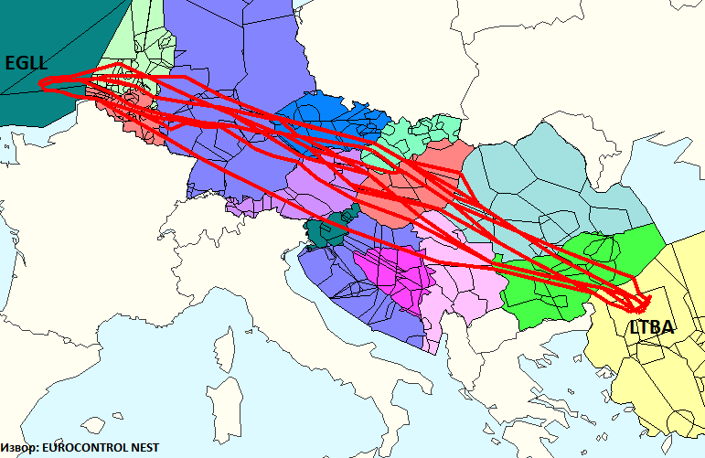
Challenges of airport-pair charging
How to define an airport-pair charge in order to recover the costs of individual Air Navigation Service Providers (ANSPs) involved in service provision for a particular airport-pair, given the uncertainty in the demand distribution over the network?
Cost-relatedness principle!
Factors affecting route choice:
Internal: A/C type, Cost Index, flight planning practices etc.
External: weather, congestion, fuel price, route network structure and availability, route charges system etc.

Slide 5
Estimating route charge variability on an airport‐pair level
Airport-Pair Unit Rate (APUR) - the unit cost of ANS provision for accommodating traffic demand on a given airport-pair:
Airport-Pair Variability Indicator (APVI):
APVI = standard deviation (APUR)*
*across the daily/weekly/monthly or even yearly APUR values

Slide 6
Impact of ATM fragmentation - analysis
Timeframe: 61 summer days (June and July 2016)
Geographical scope: flights within, to/from Europe
Trajectory type: last-filed flight plan trajectories (Eurocontrol DDR service)
Initial traffic: 1,999,713 flights and ca. 79,000 airport-pairs
Filter: airport-pairs with >= 10 days of traffic
Final dataset: 1,768,992 flights and 20,677 airport-pairs - 88% of the initial traffic demand.
Directions considered separately (A-B ≠ B-A)
APVI calculated as a standard deviation over the daily APUR values!

Slide 7
Results – charging zones overflown per flight
Large portion of flights stay within 3 charging zones (≈62%)

Slide 8
Results – APVI values for Intra-European pairs
*Each dot in the plot corresponds to one airport-pair

Slide 9
Results – geographical distribution of APVI

Slide 10
Results - airport-pairs with high APVI values
Outliers: APVI > 5 EUR

Slide 11
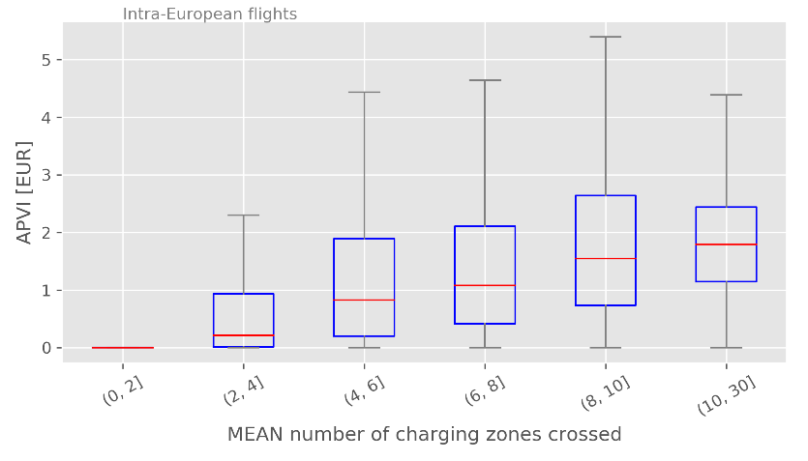
Results – APVI vs number of charging zones crossed
Example:
APVI increases with the route distance and number of (potential) charging zones crossed

Slide 12
Results – APVI vs major flows

Slide 13
Options for charging scheme
Charging based on filed flight plan
Charging based on actual route
ANSP specific unit rates
Uniform unit rate
Current scheme:
Incentives to file longer routes to avoid zones with high unit rates
Options for ‚gaming‘ (intention to deviate from filed flight plan)

Slide 14
Options for charging scheme
Charging based on filed flight plan
Charging based on actual route
ANSP specific unit rates
Uniform unit rate
Different unit rates based on actual route:
No more options for ‚gaming‘ / better predictability
More complicated administration (airline accounting)
Incentives to fly longer routes to avoid zones with high unit rates remain

Slide 15
Options for charging scheme
Charging based on filed flight plan
Charging based on actual route
ANSP specific unit rates
Uniform unit rate
Uniform unit rate:
No incentives to file/fly longer routes to avoid zones with high unit rates
Charges do not reflect different costs
“Redistribution” of revenue necessary
Costs for operating flights in different European regions change

Slide 16
Options for charging scheme
Airport pair charges:
Fixed charge for each airport-pair (only MTOW dependent)
No incentive to fly longer routes in order to save charges (but maybe other reasons, e.g. weather)
No incentive to file flight plans not in line with airlines’ preferences (but maybe other reasons, e.g. regulations)
Key question: How should the airport-pair charge be determined?
Weighted average of ANSPs’ unit rates, in order to allocate revenue based on cost as well as use of service provision

Slide 17
Options for charging scheme
B
Airport pair charges:
Different options for weights:
Shortest (plannable) route (A)
Most commonly used route (B)
Average of actually used routes (α1*A + α2*B + α3*C) – APUR
APUR enables cost related revenues, similar to current scheme
However, traffic pattern might change (compared to status quo), since no more route choices determined by different unit rates
A
C

Slide 18
Summary and way forward
Empirical analysis shows large variations in average unit rates on an airport pair level
Not surprisingly, largest variations can be observed in regions with large differences between neighbouring ANSPs
APUR might also serve as a weighting base for airport pair charges, avoiding disadvantage of choosing just one route
Future research:
Extend period for analysis (one year instead of two months)
Compare several years (including analysis of APVI due to changing unit rates)

Slide 19
Thank you very much for your attention!

Slide 20
Save the date! Engage SESAR KTN Summer School
Summer schools will include sessions on research methodologies as well as tutorials on key ATM concepts and challenges, including case studies and presentations of prominent SESAR exploratory research projects.
A number of student travel bursaries are available to support student attendance.
Belgrade, 9-13 September 2019
More info shortly on: www.engagektn.com

